Slide 1

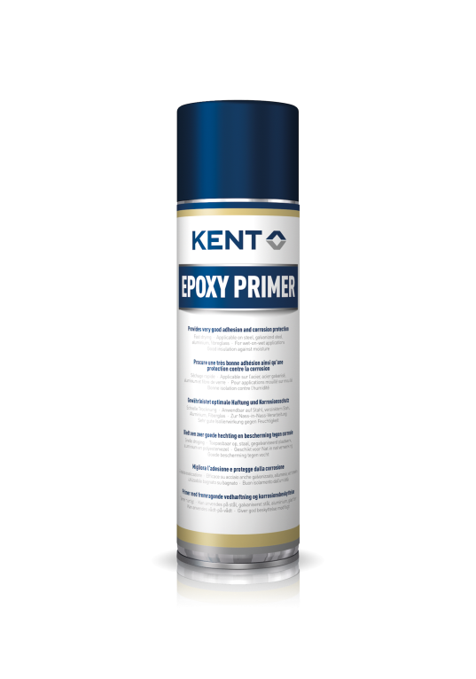
Primers, Coatings & Body Fillers
Epoxy Primer
All purpose primer with excellent adhesion. Prevents corrosion from aluminium, anodised aluminium, sheet steel & zinc coated steel.
P/N: 86375 – Epoxy Primer – 500 ml
Features
• Excellent adhesion and protection
• Quick drying time
• Good flow
• Compatible with leading paint systems
• Wet-on-wet application possible
• 10 years shelf life (at 10-25^{O}C, max 60% humidity)
Benefits
• Product will not run and will prevents corrosion
• Overpaintable after 12-15 minutes (@ 20 degree)
• Smooth finish
• No comebacks
• Time saving
• Long storage life
Application
Epoxy Primer is a 1-K primer that provides excellent adhesion and protects from corrosion. Due to its quick drying time it is ideal for spot repairs and refinishing parts. It is also weldable and you can apply putty on the primer.
This primer is drying fast with a good flow and can be applied wet-on-wet. It provides a good insulation against moisture and it is compatible with water-based and solvent-based products.
Applicable on aluminium, anodised aluminium, sheet steel, zinc coated steel, blank metal, glass fiber and plastic substrates (plastic primer recommended!).
Instructions
Remove rust, dirt, grease, dust and other contaminants.
The surface must be clean and dry.
Shake vigorously until mixing ball breaks loose. Then shake for two minutes more.
Hold can approx. 20-25 cm from surface and spray with sweeping motion several thin layers.
After spraying, turn can upside down and spray to clean valve.
Over paintable after 12-15 min. at 20 degree; 8-10 min. using IR.

Slide 2
Technical Information
Base: Epoxy resin
Consistency: Liquid (1-2 layers = 20-30 µ)
Colour: Grey
Custom tariff code: 3208 90 19
Shelf Life: 10 years (at 10-25^{O}C, max 60% humidity)
VOC: 723 g/L
Temperature resistance: To 90^{O}C
SDS available on www.kenteurope.com
Terms and Conditions
No part of this publication may be reproduced, transmitted or stored, electronically, mechanically or photocopied without the prior permission of KENT (United Kingdom) Ltd.
This data sheet and its contents (the "Information") belong to the KENT (United Kingdom) Ltd or are licensed to it. No license is granted for the use of it other than for information purposes in connection with the products to which it relates. No license of any intellectual property rights is granted.
The Information is subject to change without notice and replaces all data sheets previously supplied. The Information supplied is believed to be accurate but the Group assumes no responsibility for its accuracy or completeness, any error from or omission in it nor for any use made of it. Users of this data sheet should check for themselves the Information and the suitability of the products for their purpose and not make any assumptions based on information included or omitted. Liability for loss or damage resulting from any reliance on the Information or use of it (including
liability resulting from negligence or where the Group was aware of the possibility of such loss or damage arising) is excluded. This will not operate to limit or restrict the Group's liability for death or personal injury resulting from its negligence KENT is the trading name of KENT (United Kingdom) Ltd
Registered Office: Amber House, Showground Road, Bridgewater, Somerset, United Kingdom, TA6 6AJ
All rights reserved.
KENT (United Kingdom) Ltd, Forsyth House, Pitreavie Drive, Pitreavie Business Park, Dunfermline, Fife, KY11 8US
Tel : 0800 136925 or 01383 723344 between 08:30-17:30 Monday-Thursday, 09:00-15:00 on Fridays.
For out of hours queries please Fax us on 01383 735829 or Email: kentinfo.uk@kenteurope.com
Rev: 12/3/2018
Rev: 29.04.16

