Slide 1

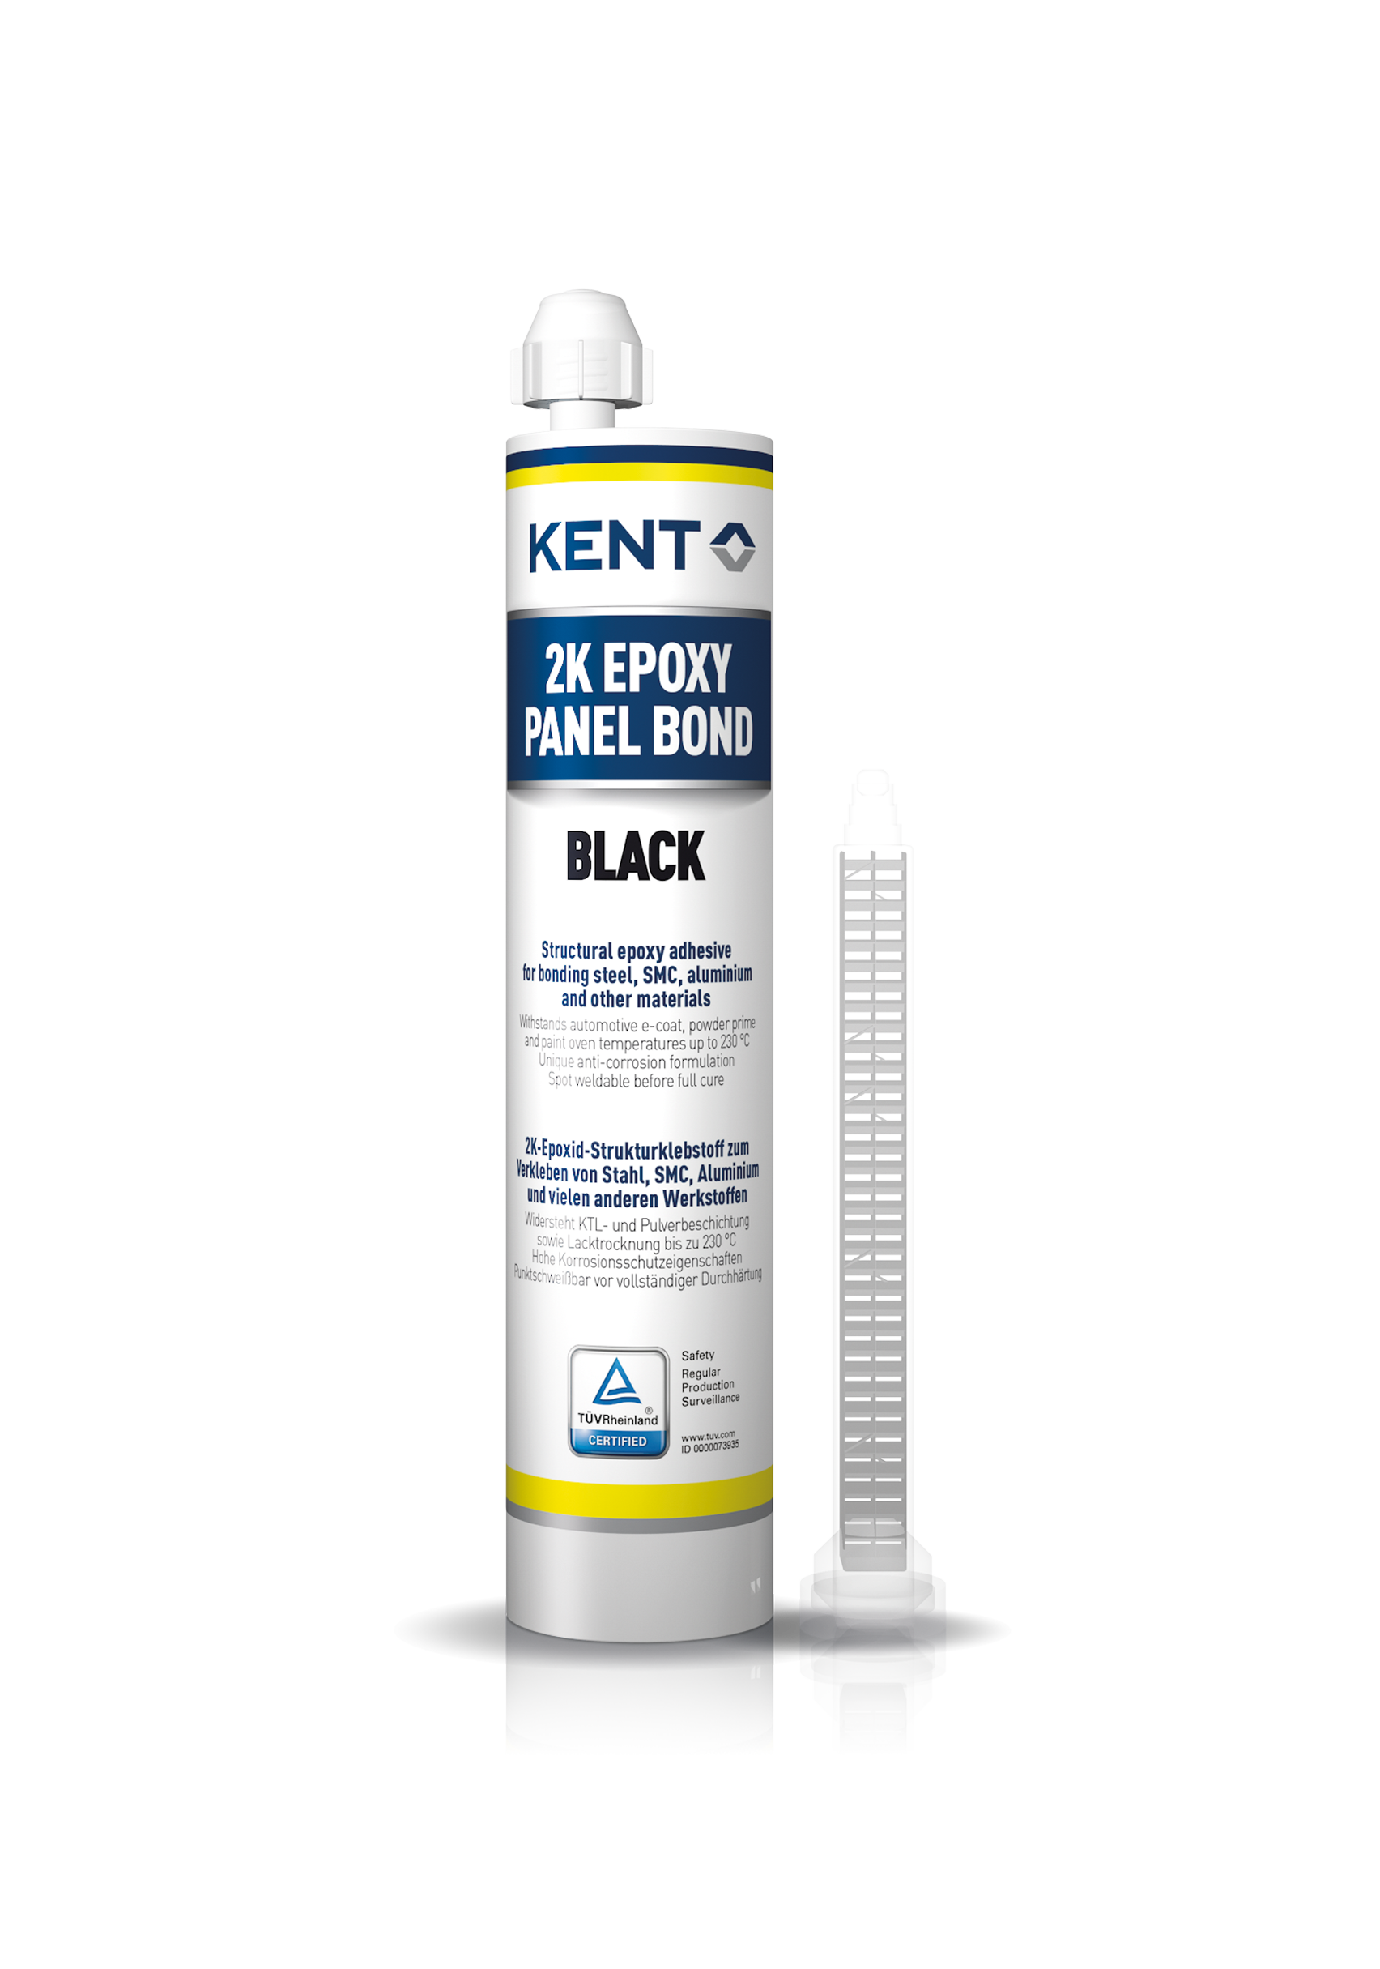
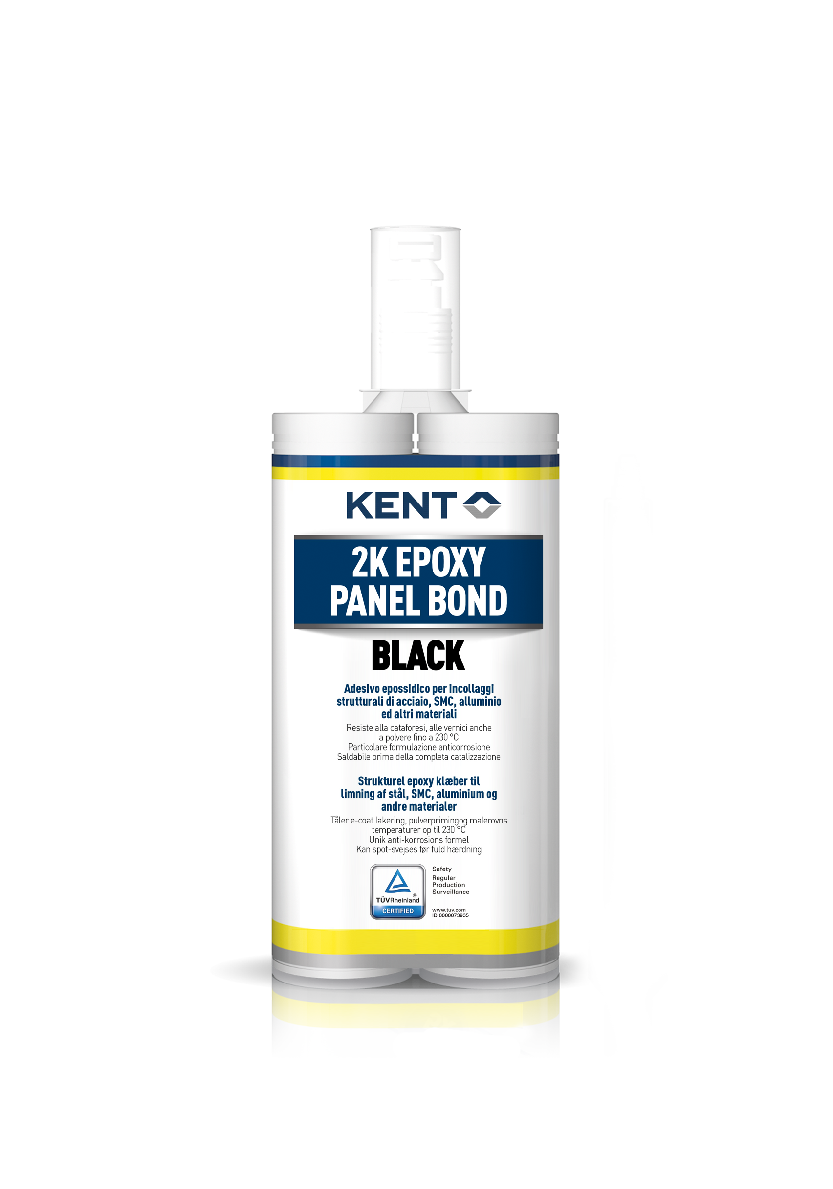

2K Epoxy Panel Bond
Two-component structural epoxy adhesive showing high chemical and heat resistance, for bonding steel, SMC, aluminium, composite materials and many other substrates
Features & Benefits
Based on epoxy resins – for improved stiffness and light weight design
Bond line thickness is controlled by 0.25mm glass beads – no need to manually control the minimum bond line thickness
Spot weldable before full cure – no need to wait 24 hours before welding
Sandable and paintable
Withstands automotive e-coat, powder prime and paint oven temperatures up to 230 ºC – very resistant to heat and chemicals
Unique anti-corrosion formulation – ideal for hybrid assemblies of metal with different substrates
High energy absorption and very good crash performance – approved by TÜV Rheinland
P/N Product S/C Packaging
86496 2K Epoxy Panel Bond 2KEPB 195 ml cartridge + 1 nozzle
87007 2K Epoxy Panel Bond 2KEPB2 220 ml cartridge + 1 nozzle
86511 Nozzles 2KEPBN Bag of 3 nozzles
Application
2K Epoxy Panel Bond provides versatility in use across a broad range of assembly requirements, from body panels, such as roofs and front fenders, to closures, such as doors, trunks, and hoods.
2K Epoxy Panel Bond offers excellent adhesion on a wide variety of substrates such as CFRP (carbon fibre reinforced plastic), SMC (sheet moulding composite), FRP (fibreglass reinforced plastic), ABS, aluminium, galvanized steel, cold rolled steel, etc.
For hybrid assemblies of two different metals, 2K Epoxy Panel Bond distinguishes itself with excellent corrosion protection and impact toughness.
2K Epoxy Panel Bond facilitates a high degree of relative motion in the joint, e.g. in the particular case of dissimilar materials bonded to each other, showing different thermal expansion coefficients.
Instructions
Clean surfaces with KENT Acrysol or Soft Surface Cleaner and allow to dry.
Sand the surfaces lightly and degrease.
Before attaching the nozzle, balance the cartridge by extruding just enough product of part A and part B.
Attach the nozzle. Extrude and dispose of the first 2 or 3 cm of the product. Apply KENT 2K Epoxy Panel Bond as required on both surfaces to be bonded. The bond line thickness is controlled by 0,25 mm glass beads contained in the adhesive. Open time: 60 minutes* / Working time: 90 minutes*. During working time the already joined parts can still be re-positioned. Do not take the bonded assembly apart.
Clamp the panel for at least 4 hours*. (Cure time can be accelerated (max. 150 ºC).
Allow 24 hours* to achieve full strength.
N.B. Due to its high viscosity, the product can be best extruded at room temperature. If stored at low temperatures, it may help to warm up the cartridge before using. * 23 ºC / 55% R.H.

Slide 2

Technical Information
Base: Epoxy-based adhesive
Consistency: Medium viscosity paste (mixed product)
Colour: Black (mixed product)
Shelf Life: 24 months
Customs Tariff Code: 3506 99 00 (2K Epoxy Panel Bond)
3923 50 90 00 (Nozzles)
VOC: 0 g/l
Cure mechanism: Room temperature or heat accelerated cure (max 150 ^{O}C)
Mixing ratio: 2:1
Specific gravity: 1.10 g/ml (mixed product)
Open time: 60 min (23 ⁰C)
Working time: 90 min (23 ⁰C)
Handling/Clamp time: 4 hours (23 ⁰C)
Full cure: 24 hours (23 ⁰C)
Hardness: Shore D 80
Shrinkage: < 2 % (ISO 3521 )
Application temp: +16 ^{O}C to +30 ^{O}C (<16 ^{O}C with IR)
Temp resistance : -40 ^{O}C to +100 ^{O}C (230 ^{O}C for 30 minutes)
Storage: indoors between 15°C to 32°C,
leave used nozzle attached to ensure sealing from humidity
Tensile strength : 30 MPa (23 ⁰C, ASTM D-638)
Elongation at break: 3 %
E-modulus: 4550 Mpa (23 ⁰C , ASTM D-638)
Lap shear strength :
Substrate | MPa
Cold Rolled Steel (1,5 mm) | 27,8
Cold Rolled Steel (0,8 mm) | 23,7
Hot Dipped Galvanized Steel (0,7 mm) | 12,6
Alloyed Galvanized Steel (0,7 mm) | 18,5
6111 Aluminium Alloy (0,9 mm) | 11,3
5052 Aluminium Alloy (0,6 mm) | 12,4
ABS | 3,0
SMC | 8,8
SDS available on www.kenteurope.com
Terms and Conditions
No part of this publication may be reproduced, transmitted or stored, electronically, mechanically or photocopied without the prior permission of KENT (United Kingdom) Ltd.
This data sheet and its contents (the "Information") belong to KENT (United Kingdom) Ltd., or are licensed to it. No license is granted for the use of it other than for information purposes in connection with the products to which it relates. No license of any intellectual property rights is granted.
The Information is subject to change without notice and replaces all data sheets previously supplied. The Information supplied is believed to be accurate but the Group assumes no responsibility for its accuracy or completeness, any error from or omission in it nor for any use made of it. Users of this data sheet should check for themselves the Information and the suitability of the products for their purpose and not make any assumptions based on information included or omitted. Liability for loss or damage resulting from any reliance on the Information or use of it (including
liability resulting from negligence or where the Group was aware of the possibility of such loss or damage arising) is excluded. This will not operate to limit or restrict the Group's liability for death or personal injury resulting from its negligence KENT is the trading name of KENT (United Kingdom) Ltd.
Registered Office: Amber House,
Showground Road, Bridgewater, Somerset, United Kingdom TA6 6AJ
All rights reserved
KENT (United Kingdom) Ltd, Forsyth House, Pitreavie Drive, Pitreavie Business Park, Dunfermline,
Fife KY11 8US Tel : 0800 136925 or 01383 723344 between 08:30-17:30
Monday-Thursday, 09:00-15:00 on Fridays’. For out of hours queries please Fax us on 01383
735829 or Email: KENTsales.UK@kenteurope.com
REV: 22/09/2022

