Slide 1

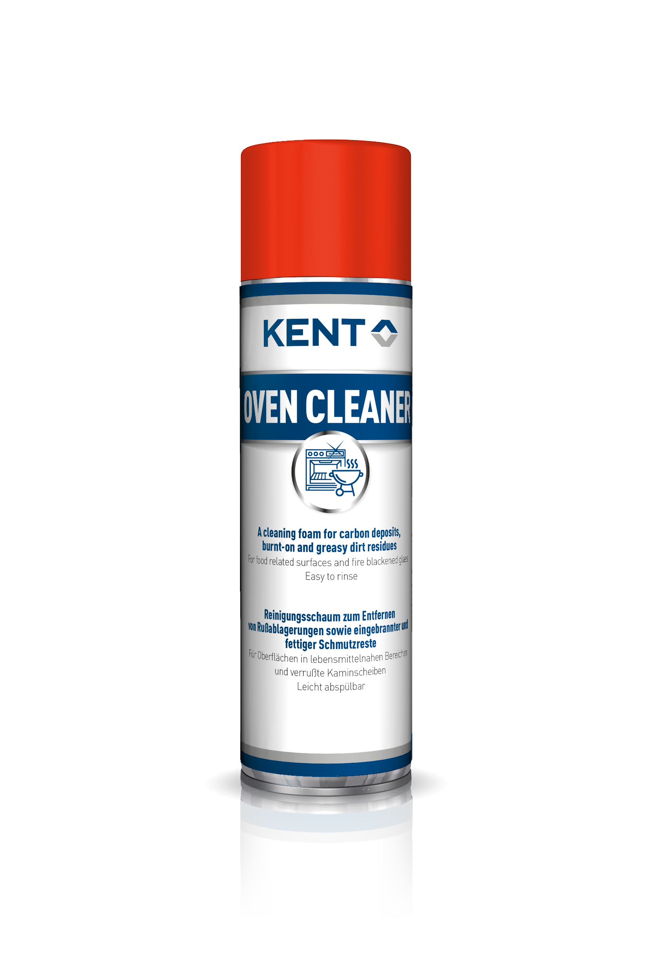
Oven Cleaner
A cleaning foam for carbon deposits, burnt-on and greasy dirt residues
Features & Benefits
Excellent adhesion on vertical surfaces – Will not run or sag
Excellent contact between the product and surface to clean – more efficient than conventional foams
Aerosol application – Even and thorough layer makes a better result
Fewer pyrolytic cleaning of ovens – saves energy and money
NSF certification category A8 – Certified degreasing cleaner for baked-on grease on all surfaces
Easy to rinse off with water – Convenient for a perfectly clean result on food related surfaces
P/N | Product | S/C | Packaging
C0002 | Oven Cleaner | KOV | 500 ml aerosol
Application
KENT Oven Cleaner foam will clean surfaces of conventional or pyrolysis ovens, vitroceramic or induction hobs, grills, griddles, planchas and barbecues, extractor hood grills, dishes and grill pans, stove and fireplace windows.
Direct contact with food is not permitted. Rinsing is mandatory.
Instructions for Use
Shake can well before use. Spray on cold surfaces.
Thoroughly spray the dirty area and leave to take effect for at least 10 minutes.
Take foam residues out with a paper towel or sponge
Rinse thoroughly with potable water after use.
Wipe with a cloth to dry surface
Repeat application for stubborn dirt and leave posing for a longer time, up to several hours if needed
Nota : Keep away from foodstuffs, beverages and food. Wear protective gloves and glasses while using product
REV: 16/10/2025

Slide 2


Technical Information
Base: | Water based foam cleaner
Appearance / colour: | White foam
Odour: | Light
Density | 1,056 g/cm3
pH: | 13,6
Dilution ratio: | Not applicable
Solubility in water: | Fully miscible – to be rinsed with potable water for food related purpose
Application temp: | +10 to 35 ºC
VOC: | 143,4 g/l
Shelf life: | 24 months
Custom tariff code: NSF Registration : yes | 34025090 Category A8 – Registration number : xxx
Health & Safety Information
H222 Flammable aerosol
H229 Pressurised container: May burst if heated
H314 Causes severe skin burns and eye damage
H318 Causes serious eye damage
SDS available on www.kenteurope.com Always follow the information on the product label.
Terms and Conditions
No part of this publication may be reproduced, transmitted or stored, electronically, mechanically or photocopied without the prior permission of Barnes Group KENT Ltd.
This data sheet and its contents (the "Information") belong to the Barnes Group KENT Ltd or are licensed to it. No licence is granted for the use of it other than for information purposes in connection with the products to which it relates. No licence of any intellectual property rights is granted.
The Information is subject to change without notice and replaces all data sheets previously supplied. The Information supplied is believed to be accurate but the Group assumes no responsibility for its accuracy or completeness, any error from or omission in it nor for any use made of it. Users of this data sheet should check for themselves the Information and the suitability of the products for their purpose and not make any assumptions based on information included or omitted. Liability for loss or damage resulting from any reliance on the Information or use of it (including
liability resulting from negligence or where the Group was aware of the possibility of such loss or damage arising) is excluded. This will not operate to limit or restrict the Group's liability for death or personal injury resulting from its negligence KENT is the trading name of Barnes Group KENT Ltd.
Registered Office: Barnes Group KENT Ltd. Registered in England. Pitreavie Crescent, Pitreavie Business Park, Dunfermline Fife KY11 8UQ.Registered in England Nº: 1164516
VAT Registration Nº: 887 1228 94
All rights reserved.
KENT UK Forsyth House, Pitreavie Drive, Pitreavie Business Park, Dunfermline, Fife KY11 8US T: 0800 / 136 925 F: 01383 / 735 829 Email: KENTsales.UK@kenteurope.com
REV: 16/10/2025

